Slide 1
Supabase project

Slide 2
What we are going to do
In our Supabase and Vite project, we have successfully connected the Vite UI, which utilizes TypeScript, with the Supabase SQL database. We have already demonstrated an example of fetching data.
Now, we are going to create a new project that involves a one-to-many relationship between countries and cities. For each country, there will be multiple cities associated with it.
In this project, we will implement the CRUD operations (create, read, update, delete) for both countries and cities. This means we will be able to create, update, and delete countries and cities as needed.

Slide 3
Create the tables
Firstly, we will create the necessary tables. We'll start by creating the "country" table, which will consist of an auto-generated "id" column and a "text" column that cannot be null.
Secondly, we will create the "city" table, which will establish a relationship with the "country" table. The structure of the "city" table will be as follows:
"city_id" (auto-generated integer)
"country_id" (referring to the corresponding country)
"city_name" (text)

Slide 4
Connect vite and supabase
Next, we will establish the connection between the two projects by retrieving the supabaseUrl and supabaseKey from the Supabase dashboard.
To achieve this, we will use the provided supabaseUrl and supabaseKey to create a Supabase client object using the createClient function. Here's an example of how to do it:
const supabase = createClient(supabaseUrl, supabaseKey);
By passing the supabaseUrl and supabaseKey as arguments to createClient, we can create an instance of the Supabase client, which will allow us to interact with the Supabase API and perform various database operations.

Slide 5
CRUD
Let's proceed with creating asynchronous functions to handle data operations such as fetching, creating, inserting, and deleting.
getCountries, deleteCountry, insertCountry, createCountry

Slide 6
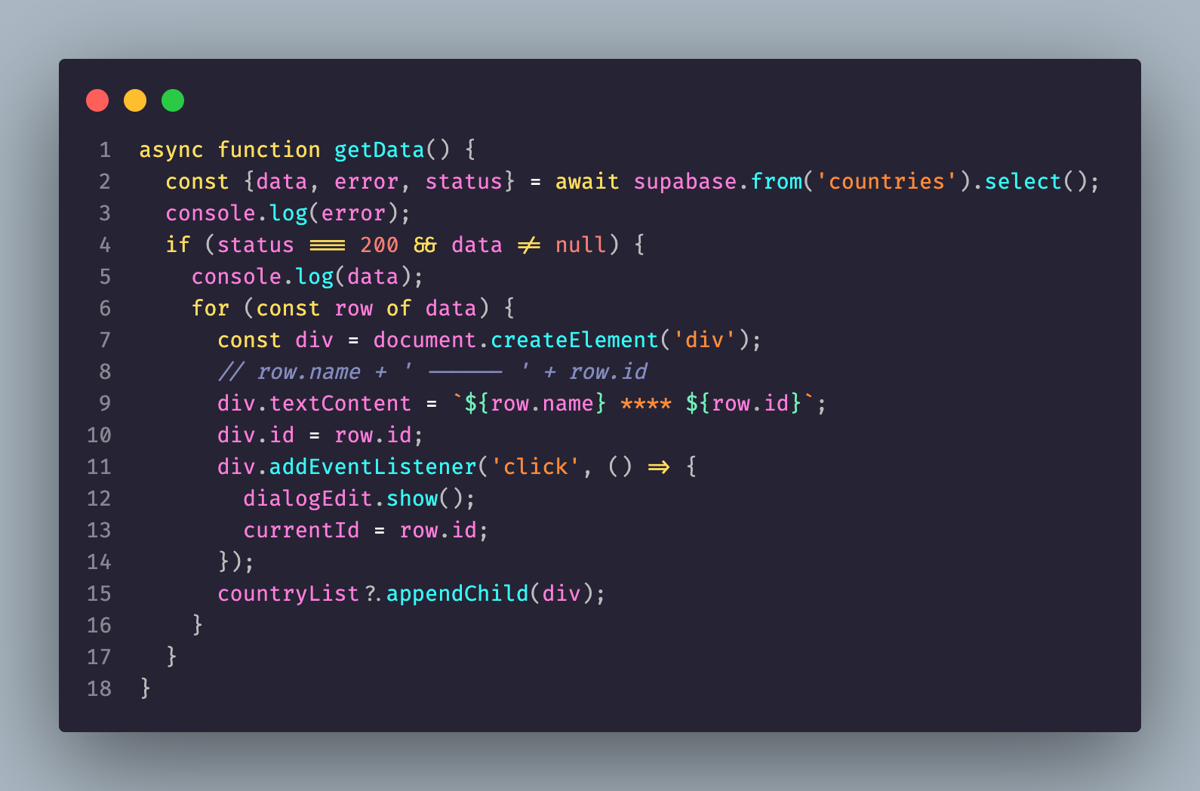
getData

Slide 7
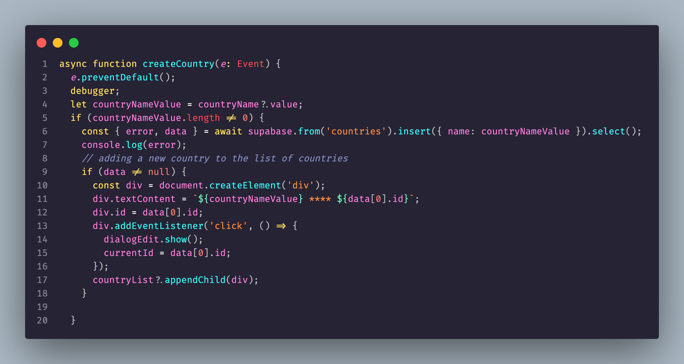
Create data

Slide 8
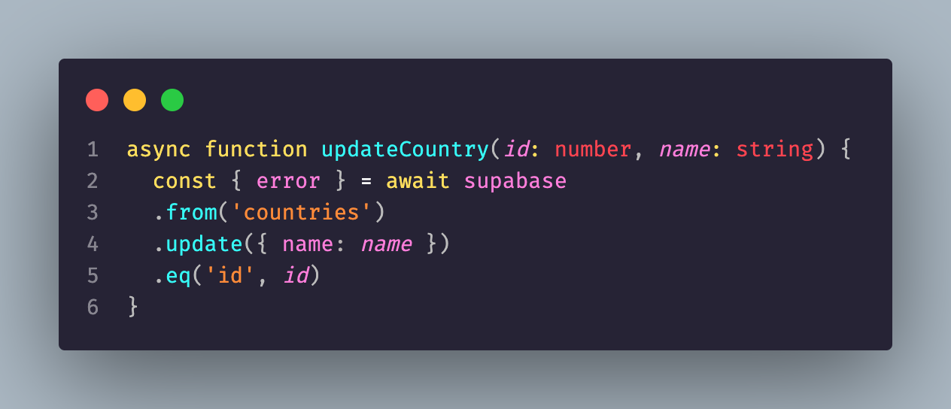
Update data

Slide 9
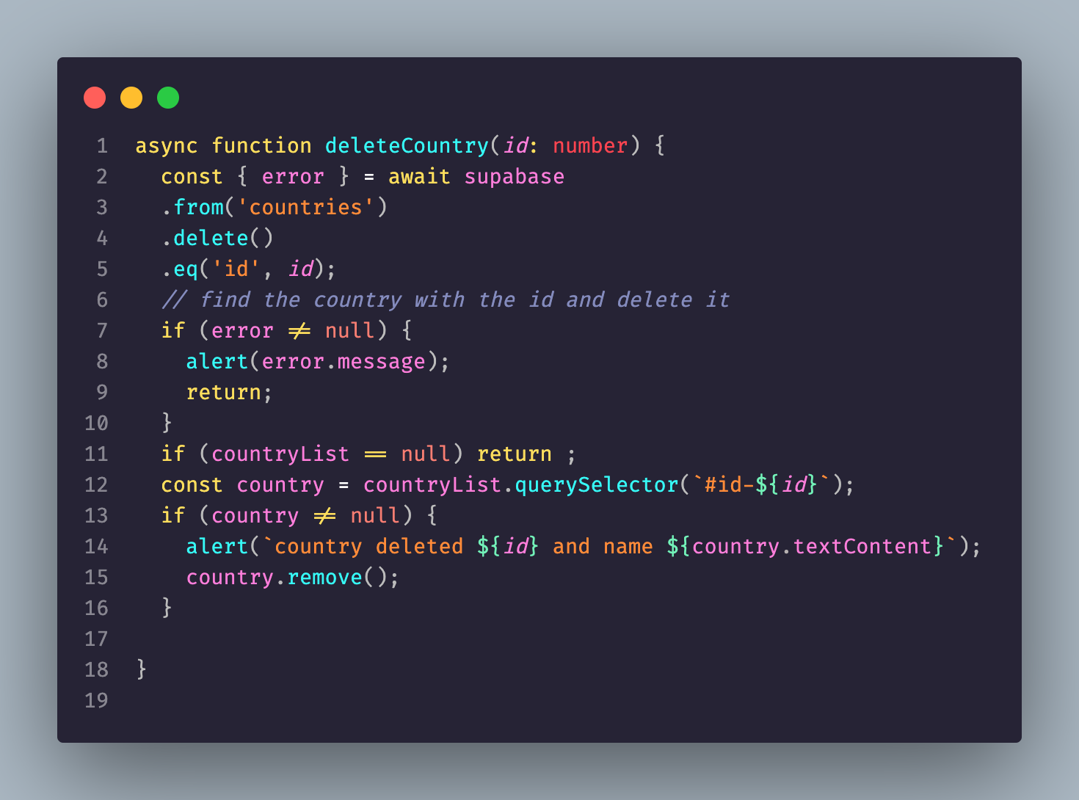
Delete data

Slide 10
Import types- login first
npm i supabase@">=1.8.1" --save-dev
npx supabase login
-- you can get the access token from the supabase dashboard at https://app.supabase.com/account/tokens

Slide 11
Second steps gen types
npx supabase gen types typescript --project-id "project id is the reference id" --schema public > ./src/lib/schema.ts
--you can find it in the general settings of your project

Slide 12
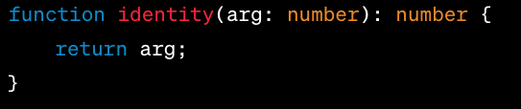
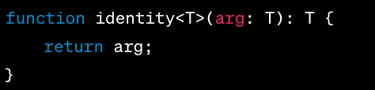
generics
Generics is a concept in TypeScript (and other languages such as Java, C#, etc.) that allows the creation of reusable code components that can work over a variety of types rather than a single one.
This allows users to consume these components and use their own types.

Slide 13
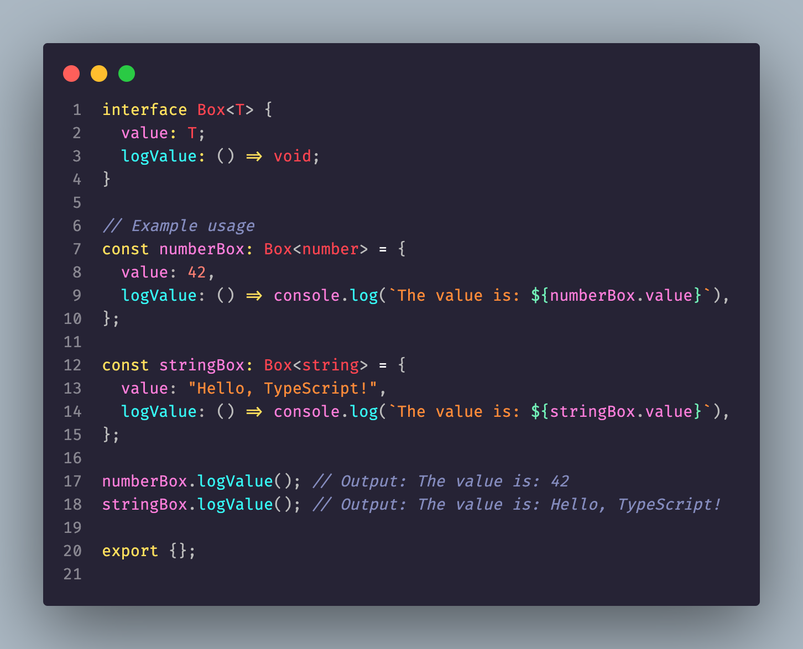
Generic with interface
In TypeScript, generics provide a way to create reusable components that can work with different types. When combined with interfaces, generics allow you to define flexible and type-safe structures.

Slide 14
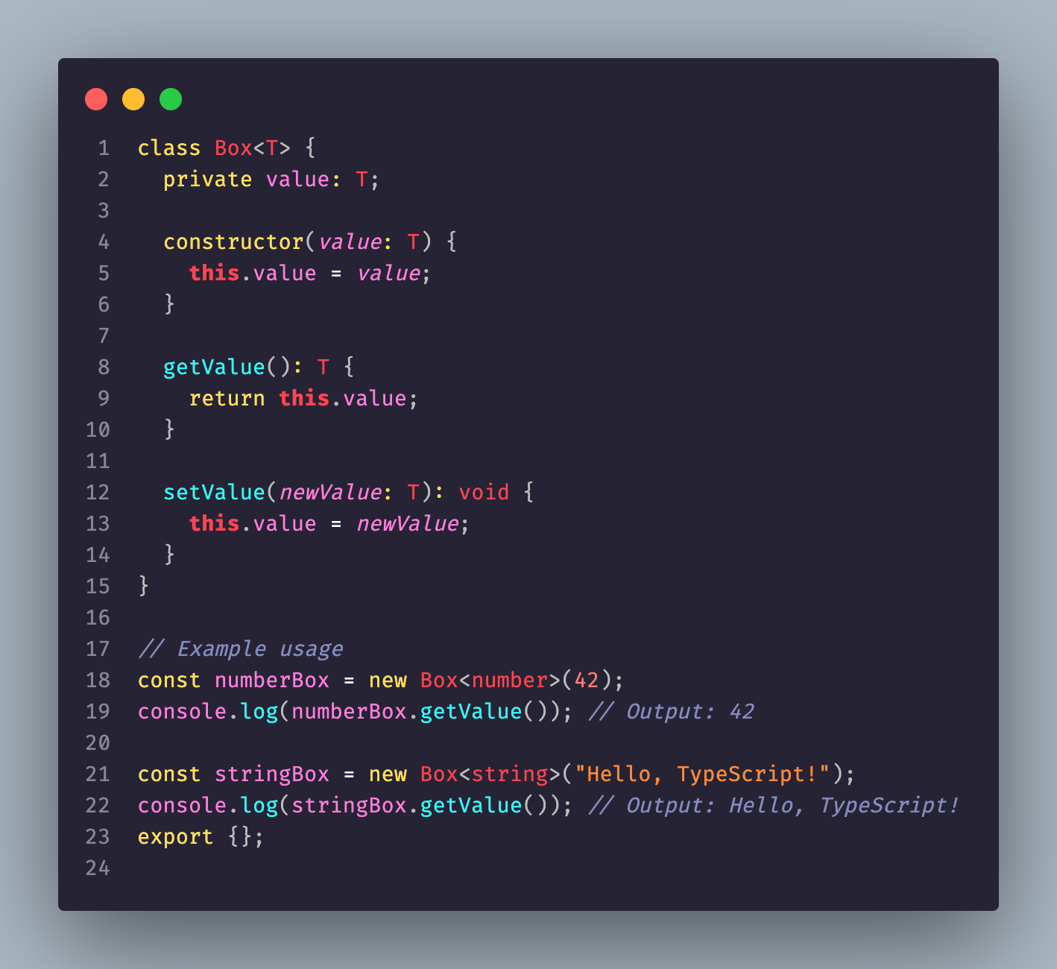
Generic classes
Generics with classes in TypeScript allow you to create reusable classes that can work with different types. You can define a generic class by specifying a type parameter that can be used throughout the class definition. Here's an example:

